Slide 1
MMAI 847 – Capstone Creating a Great Project Plan

Slide 2
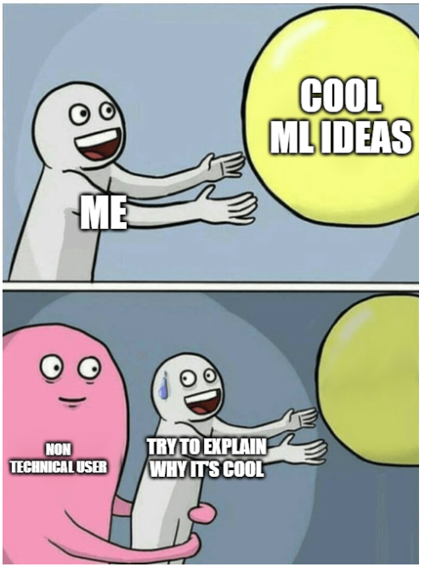
Today’s Agenda
Purpose of a project plan
Key sections of a project plan
Project Overview
Scope, Tasks and Deliverables
Exit and acceptance criteria
Summary

Slide 3
Purpose of a Project Plan
It provides a shared vision for what the project will accomplish – this common understanding can bind the team together in completing actions that satisfy the project’s goals.
It gives clarity on the responsibilities of team members and other organizations in contributing to the goals of the project.
It organizes the work of the project and can be used to prevent extraneous work from crowding out legitimate project activities.
It can be a very powerful communication mechanism, supplementing verbal interactions. This is an important written reference for the team and can also be used with other stakeholders.
[1] PMO Notebook: https://www.pinnacleprojects.com/index.php/the-project-plan-sp-1739577267/109-the-importance-of-a-project-plan
Notes:
PMO Notebook:
https://www.pinnacleprojects.com/index.php/the-project-plan-sp-1739577267/109-the-importance-of-a-project-plan

Slide 4


Purpose of a Project Plan
A well written project plan bubble wraps you and your project team!
SCOPE
TIME
RESOURCES

Slide 5
What is not a project plan?
1. Just a list of the sponsor’s favorite buzzwords stringed into an idea
Without clear business objectives or well defined value, it cannot become a justifiable project
2. Just a wish list of potential ideas
The scope of the project should be well defined
3. Just a list of tasks to be completed
The list of must-haves vs. nice-to-haves should be defined and tied to the overall project objectives
4. Just a schedule for completing the list of tasks
Dependences between tasks and the corresponding critical path/ parallel paths should be identified

Slide 6
Project Overview
MMAI 847 – Capstone
Creating a Great Project Plan

Slide 7
The Project Overview Statement (POS)
Sections | Details
Problem/ Opportunity | Explain why this project is needed. What are we trying to fix? Or Enhance? What would be the benefits of doing this? Or downside if it is not done?
Goal | How would it change the work that is currently done?
Objectives | What needs to be completed to achieve the goal?
Success Criteria | Quantify the outcome of the implementation. i.e. X will decrease/increase by Y% after implementation
Assumptions, Risks, Obstacles | Are there external/ internal factors that could potentially impact this project?
[2] Effective Software Project Management, Robert K. Wysocki Ph.D.: https://learning.oreilly.com/library/view/effective-software-project/9780764596360/9780764596360_ch04lev1sec4.html

Slide 8
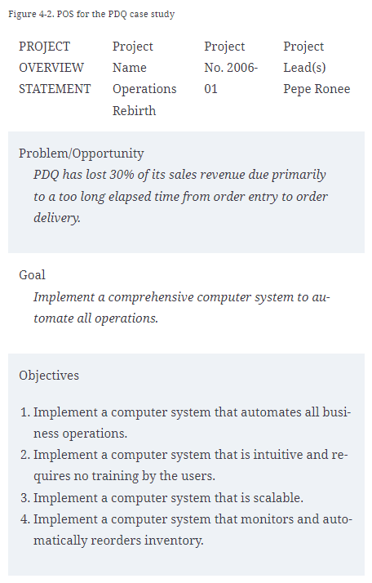
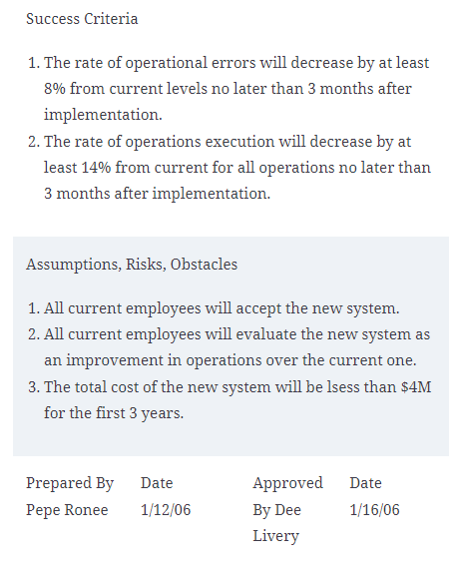
Example
[2] Effective Software Project Management, Robert K. Wysocki Ph.D.: https://learning.oreilly.com/library/view/effective-software-project/9780764596360/9780764596360_ch04lev1sec4.html

Slide 9

Exercise #1

Slide 10
Exercise #1 – Create a POS
Using information from MMAI 891 Team Project on Zindi
https://smithlearning.ca/d2l/le/content/606789/viewContent/4631936/View
https://zindi.africa/competitions/to-vaccinate-or-not-to-vaccinate
Create a Project Overview Statement (POS)

Slide 11
Identify key stakeholders
Understanding Responsibility Assignment Matrix (RACI Matrix)
Role | Explanation
Responsible | Person who is completing the task (i.e., development team)
Accountable | Person who is making decisions and taking actions on the task (i.e., implementation team)
Consulted | Person who will be communicated with regards to the decision-making process (i.e., project sponsors, or downstream impacted users)
Informed | Person who will be updated on decisions and actions throughout the project (i.e., downstream but unimpacted users)
[3] Project Management, Understanding Responsibility Assignment Matrix.: https://project-management.com/understanding-responsibility-assignment-matrix-raci-matrix/

Slide 12
Scope, Tasks and deliverables
MMAI 847 – Capstone
Creating a Great Project Plan

Slide 13
Scope, Tasks and Deliverables
Referencing your list of objectives on the POS:
Define in-scope and out-of-scope tasks
Within in-scope tasks: identify must-haves vs. nice-to-haves
Determine the implementation strategy: linear, incremental, iterative etc.
Breakdown tasks and identify dependencies & critical path
When changes to the objectives arise, this will need to be reviewed and revised, and agreed among all key stakeholders.

Slide 14
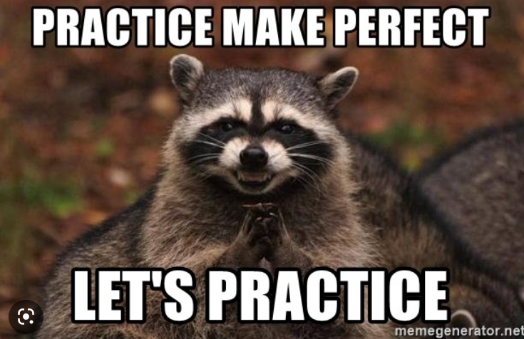
Exercise #2

Slide 15
Exercise #2a – Defining Tasks
Continuing with the vaccine project
Define 5 in-scope tasks
Identify priority: must-haves vs. nice-to-haves
Define 3 out-of-scope tasks

Slide 16
Exercise #2b – Define Task Dependency
Define the task dependency based on your list of in-scope tasks
Create a critical path for the must-have tasks

Slide 17
Discussion – Scenario #1
What happened?
What should the team do?
The description of the project provided by the sponsor is very generic

Slide 18
Discussion – Scenario #2
What happened?
What should the team do?
Project sponsor came up with a new idea during a check-in meeting
4 weeks until final presentation

Slide 19
Exit Criteria
MMAI 847 – Capstone
Creating a Great Project Plan

Slide 20
Exit Criteria
Referencing your list of in-scope and must-have deliverables as items to be delivered at the end of the project.
What does completion look like for each of these deliverable?
Tie back to project benefits: what will the project sponsor gain from the completion of these deliverables (individually or in aggregate)
Identify the impact if any part of the scope is not completed
[4] Project Management Institute, Project closing: the small process group with big impact: https://www.pmi.org/learning/library/importance-of-closing-process-group-9949

Slide 21

Exercise #3

Slide 22
Exercise #3 – Defining Exit Criteria
Continuing with the vaccine project
Recap what will be delivered at the end of the project
For each of the in-scope tasks, describe what “completion” should look like – tie back to project benefits if possible

Slide 23
Scenario #3
What happened?
What should the team do?
During the final presentation, the project sponsor asks about a task that was considered a nice-to-have
The team ran out of time and did not get to complete that task

Slide 24
Final Thoughts
MMAI 847 – Capstone
Creating a Great Project Plan

Slide 25
Final Thoughts
Use the project plan as your on-going reference document:
to make sure everything you are doing still aligns with the overall objectives of the project -> if it’s not, don’t do it
when your project sponsor requests for changes (in priority, or scope, or resources) -> to renegotiate priority, scope, or resources as needed
when you run into unforeseen showstoppers/ roadblocks -> to assess impact and report potential timeline deviation

Slide 26
Purpose of a Project Plan
REMEMBER!!!
A well written project plan bubble wraps you and your project team!
SCOPE
TIME
RESOURCES

